Slide 1
Connection to the Industrial Revolution
Europeans needed a source of raw materials to put in their new factories
Europeans also wanted places to sell all of the items that they were mass-producing in their factories

Slide 2
Age of imperialism
Imperialism refers to Empire-building by the nations of Europe.
Nations from Europe went into un-claimed areas of the world (mainly Africa and Asia) and began to establish colonies.
Great Britain and France were the two major powers during this time, and colonized much of Africa and Asia.

Slide 3
Cultural diffusion
Pros | Cons
Trade of new goods between nations | European practices were forced on colonies
Africa receives European medicine and education | European countries drew arbitrary boundaries for new colonies that ignored cultural problems (rival tribes put in the same country)
Africa receives European laws and culture | Europeans used their superior weapons and power to exploit African and Asian workers
Spread of religious beliefs | Europeans became extremely racist to justify their mistreatment of the “inferior races.”
Europe became more wealthy due to the increased trade and resources taken from African nations

Slide 4
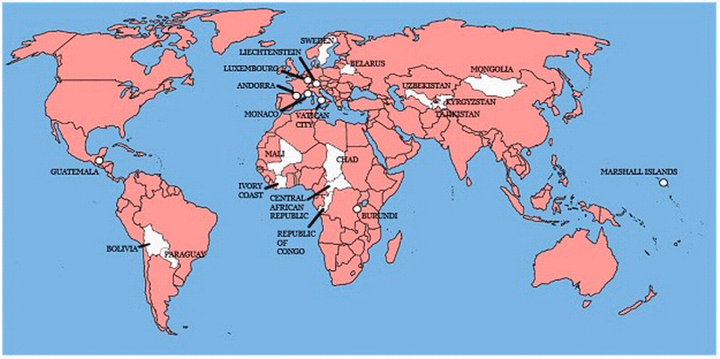
The Sun never sets…
British were the most active during this time in spreading their culture and acquiring colonies.
British superiority was due to the best navy in the world, which was able to protect their trade routes with colonies and other countries
British also treated their colonies better, and didn’t make them change as much, which made relationships with those colonies better in general.

Slide 5
French imperialism
The French also gained many colonies in SE Asia and Northern Africa.
French utilized a much harsher method of control over their colonies referred to as “Direct Rule.”
Did not respect other cultures and wanted every colony to operate exactly the way that France did with French laws, customs, language and culture.

Slide 6
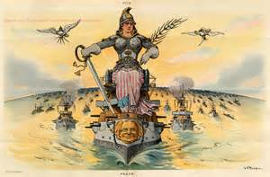
American imperialism
America never took part in the African or Asian imperialistic pursuits
Main focus was on Cuba, Philippines, Hawaii, and other Pacific Islands.
The other main focus of American Imperialism was on annexing territories that were formerly controlled by Spain, France, and Mexico on the American continent.

Slide 7
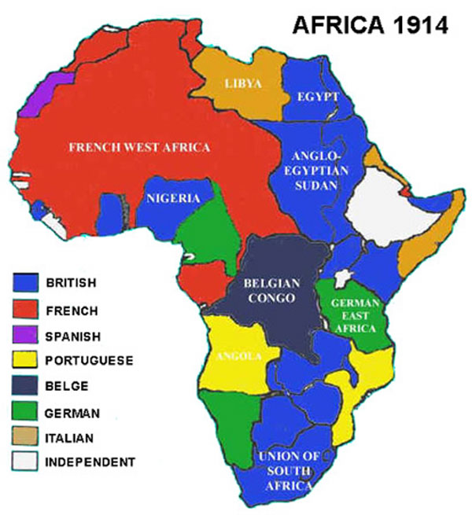
Imperialism maps--1914

Slide 8
darwinism
Darwinism is the belief that natural selection allows the best suited organisms to be the most successful in nature.
Social Darwinism— Survival of the fittest. Those that are the strongest survive and reproduce more.

Slide 9
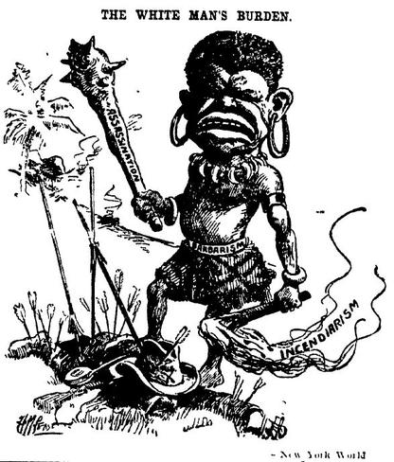
The White Man’s Burden
The idea that the Europeans and Americans were doing the indigenous people of their colonies a favor by bringing culture and civilization
Extremely racist
Africans and Asians are unintelligent, under-developed, and almost animal-like.
Justified taking all that they did away from the colonies because of the “sacrifice” they were making to bring their culture to these people.

Slide 10
The end of the Imperial Age
Once all of the areas of the world had been explored, claimed, and colonized, countries began to clash and fight wars throughout the world over control of certain colonies.
These wars led to increased nationalism, and extremely strong national identity.
I am British, I am French, I am American, etc.
Eventually these wars would spill over into Europe, and would be one of the ultimate causes of World War 1.
Imperialism is the reason why World War 1 is a WORLD War. Mother countries would force their colonies to send troops and resources to fight on their side during the war.

Slide 11
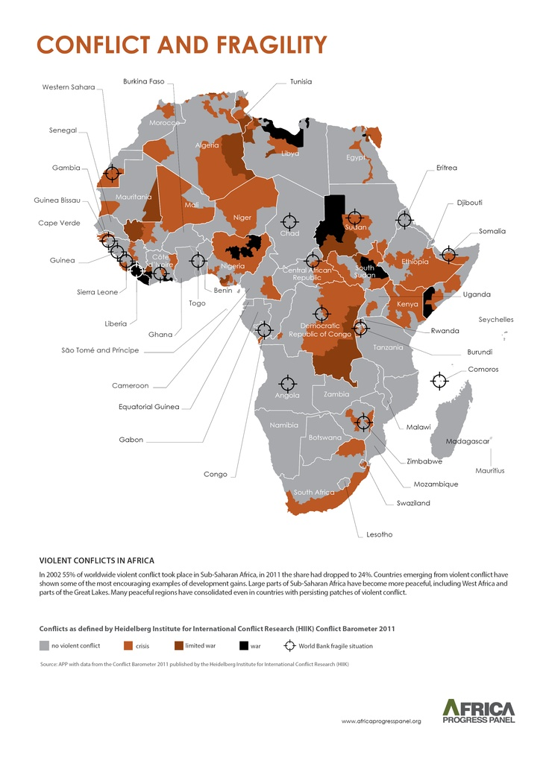
The legacy of imperialism
Countries controlled by British were better prepared for self-rule since their leaders had not been displaced during British control.
Smoother transitions when the British left
More stable governments today
Racism still existed in the colonies. Once the colonies were granted independence, often the British colonists would continue to establish laws that benefited the within the colony (South Africa—Apartheid)
Many African nations ruled by France and other countries were unprepared to self-rule at all, and those countries struggle to maintain stable governments even today.

Slide 12
Imperialism pop Quiz
Who were the 2 major powers during this time period?
Name one PRO and one CON of the Age of Imperialism.
“The sun never sets on the British Empire.” Explain what this means.
What is the meaning of Indirect rule? Who used this approach?
What is the meaning if Direct rule? Who used this approach?
Why was the British able to conquer the most land during this time?
Why did America not focus on Africa? What areas did they focus on?
What is social Darwinism?
Describe the White Mans Burden in at least 3 sentences.
How did the Industrial Revolution cause the Age of Imperialism?
What is the legacy of Imperialism?

Slide 13
Interpreting Political Cartoons
Just look at the picture
Take note of who is drawn and how they are made to look
Read the labels
Make sure you understand what the different parts of the picture are and what they represent
Look for sarcasm
People doing the opposite of the label or things that don’t make sense. When they don’t fit, the artist is making fun of someone.

Slide 15
Create this Chart in your notes
 | Clues (What did the artist/author put in the picture that you recognize that can help you understand their point) | Who looks good? Who looks bad? | Message: What is the point?
1.
2.
3.
4.
5.
6.
7.
8.
9.
10.

Slide 26
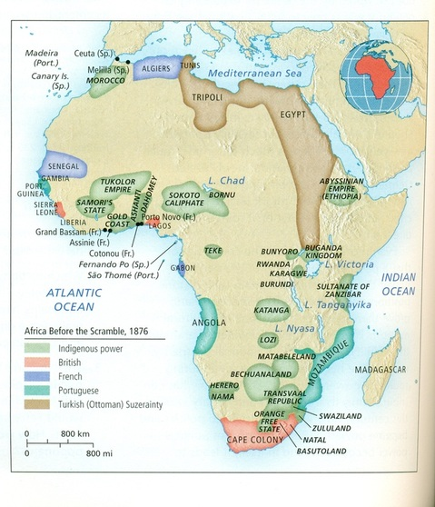
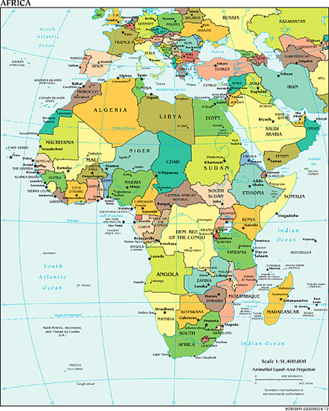
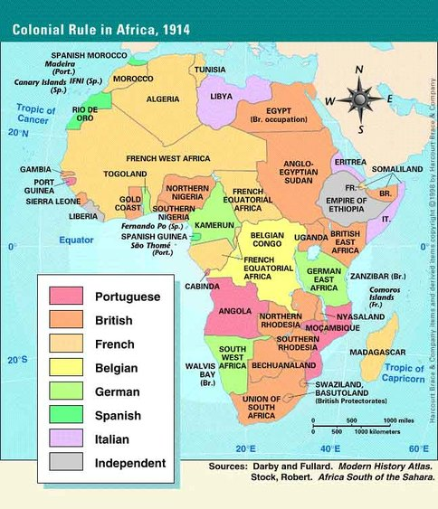

Slide 27
Use the graph to answer the questions
1. Who seems to be the "winners" of the "scramble for Africa"?
2. How much of Africa was controlled by non-European powers?
3. How many African countries are listed in the diagram? Why is this significant?

