Slide 1
The Industrial Revolution
Powerpoint by: Mr. Nathan Gilson.
Ms. Alecia Bryant

Slide 2
Industrial Revolution (WHO)
The Industrial Revolution started in Great Britain, it spread throughout Europe and later to the Americas.

Slide 3
The Industrial Revolution: (WHEN)
The Industrial Revolution started in the 1700s and came to a close in the 1900s.

Slide 4
The Industrial Revolution: (WHAT)
The Industrial Revolution: Use of power-driven machinery was developed, to improve society.

Slide 5
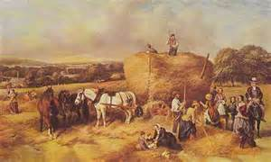
Before the revolution
Societies based on Agriculture
Smaller towns and very rural
Most people engaged in subsistence farming
Agrarian Society

Slide 6
Time for A Change
Wealthy famers began to experiment with better agricultural methods.
Jethro Tull invented the seed drill in 1701.
Machine that made planting grain much more efficient.
Enclosure Movement: Wealthy farmers bought lager pieces of land to grow a larger supply of crops.
This led some poor farmers to move to the city since they could not afford to buy large pieces of land in the countryside.

Slide 7
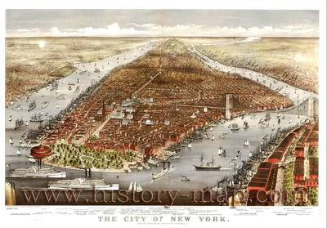
Move to the cities
In order to move to the cities, someone needs to grow food for those people
Advances in agricultural technology allow a farmer to support a greater population
The process of people moving to cities is called Urbanization

Slide 8
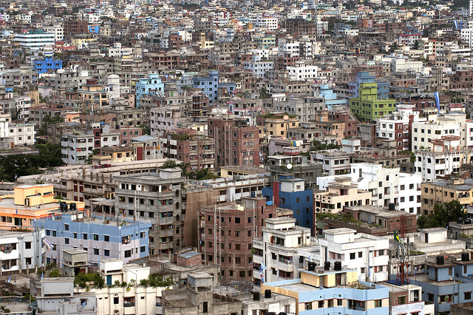
Problems associated with urbanization
1. People moving have no skills, therefore they do not command a high salary
2. Most people sold their belongings to move to the city (no going back)
3. Overcrowding.
City infrastructure not built for such a large population
Diseases

Slide 9
Time for a change
Britain's Textile (or cloth) industry changed due to industrialization.
Eli Whitney created the Cotton Gin which removed the seeds from cotton more effectively.
James Hargreaves created the Spinning Jenny which spun the seedless cotton into thread or yarn.
Richard Arkwright created a more efficient version of this, which produced stronger thread.
These large machines were housed in factories.

Slide 10
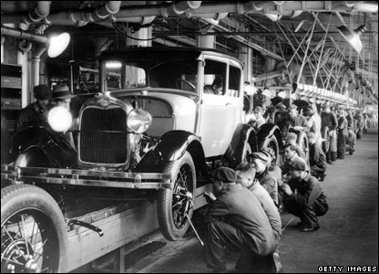
Mass production
Mass production is making a large quantity of a good using machines
Specialization—people who do the same thing over and over get good at it
Machines do a lot of the work that people used to do
Factories produce a lot of pollution also

Slide 11
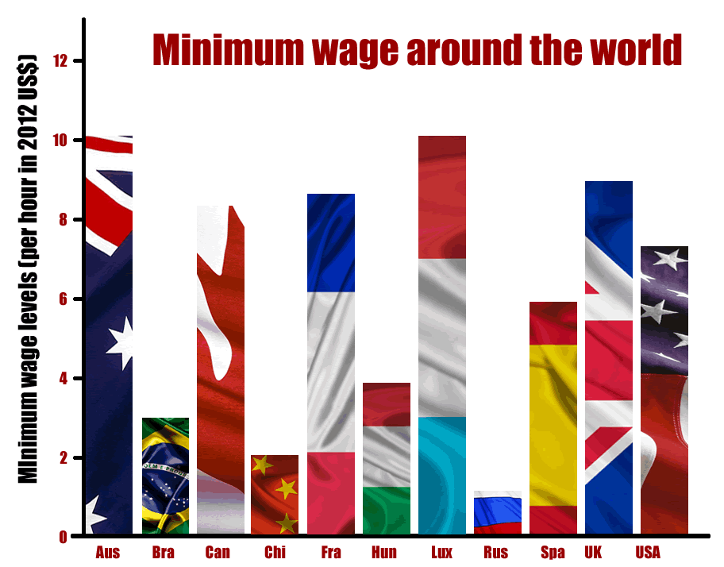
Lack of regulation
No minimum wage
No safety standards for workers
No Child labor laws
The problem with regulation is that it increases costs of production

Slide 12
Steam Powers The Revolution
the Steam Engine.
This invention used water (heated by fire) to create steam which created the energy needed to run the new machines in factories.
No electricity!
The Steam Engine was also used to navigate boats.
Coal
Coal powered the majority of the steam engines. While more and more factories ran on these steam engines, factories were built near coal mines.

Slide 13
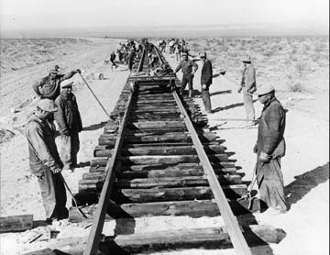
Machines that change our World
Railroad—transportation of large quantities of goods in shorter time
Telegraph—communication over long distances at speed of light
Light bulb—no oil, gas, or candles needed to see

Slide 14
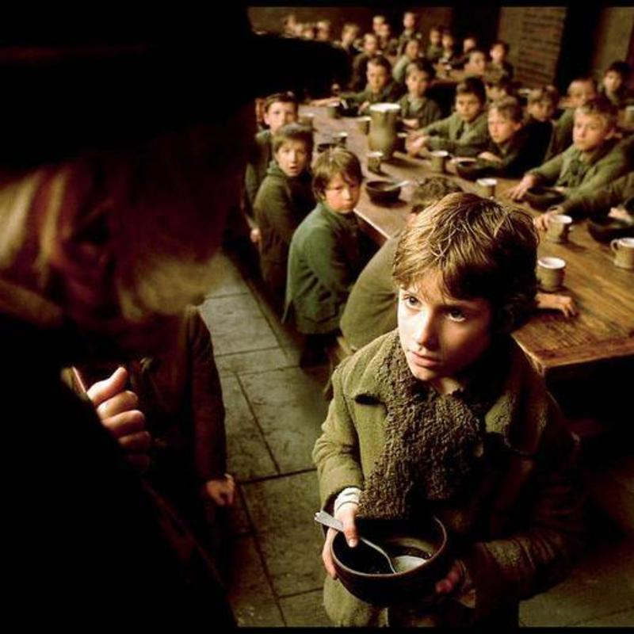
Exploitation of the working poor
Charles dickens wrote a lot about the working poor
A Christmas carol
Oliver Twist
Most people could not afford not to work
Medicine for sick children
Food, rent, clothes
Many orphans were forced to work, while the people who took care of them kept the money they made for themselves.

Slide 15
With great power…comes great responsibility
Massive ecological impact—pollution from factories ruins water and air in and around cities. Cities physically take up land, destroying environments
Complete change of the way we fight wars (by World War 1)
Many wealthy people mistreat or abuse their workers
Make people into “slaves” because the factory owner owns apartment, food source, and your workplace

Slide 16
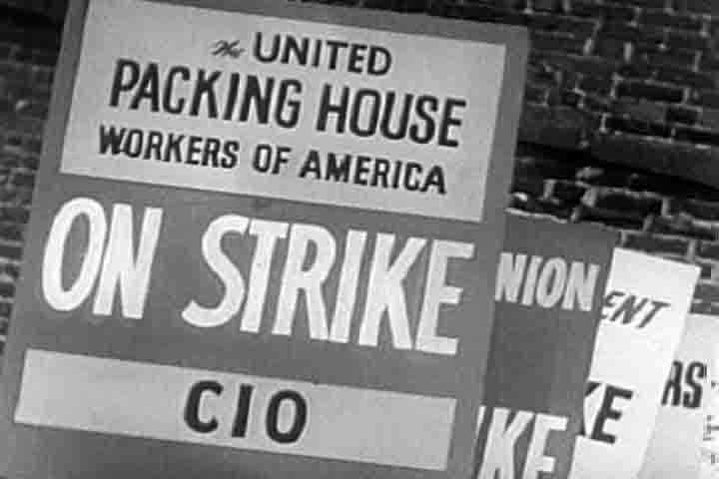
Power to the people
Women working in more prominent roles in the businesses start to fight for equal rights to men
Voting rights expanded beyond just people who own land or have education
Labor unions
Public education expanded

