Slide 1
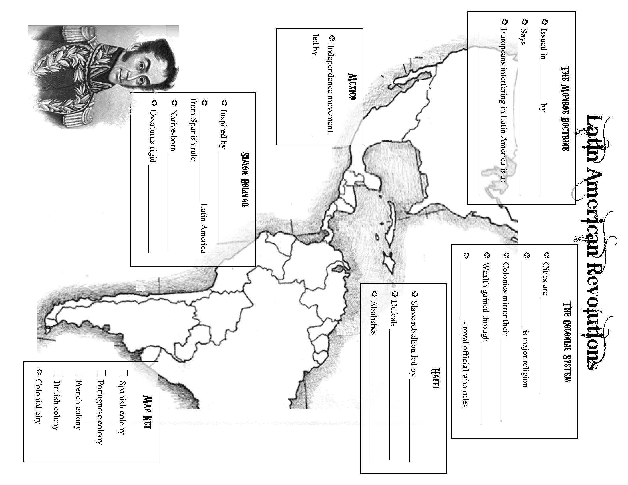

Slide 2
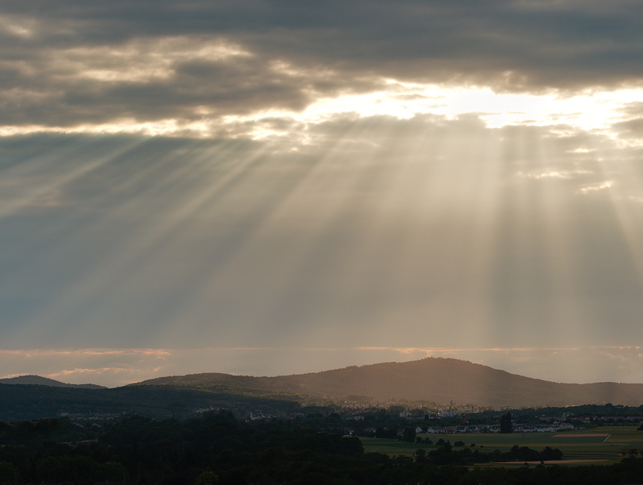
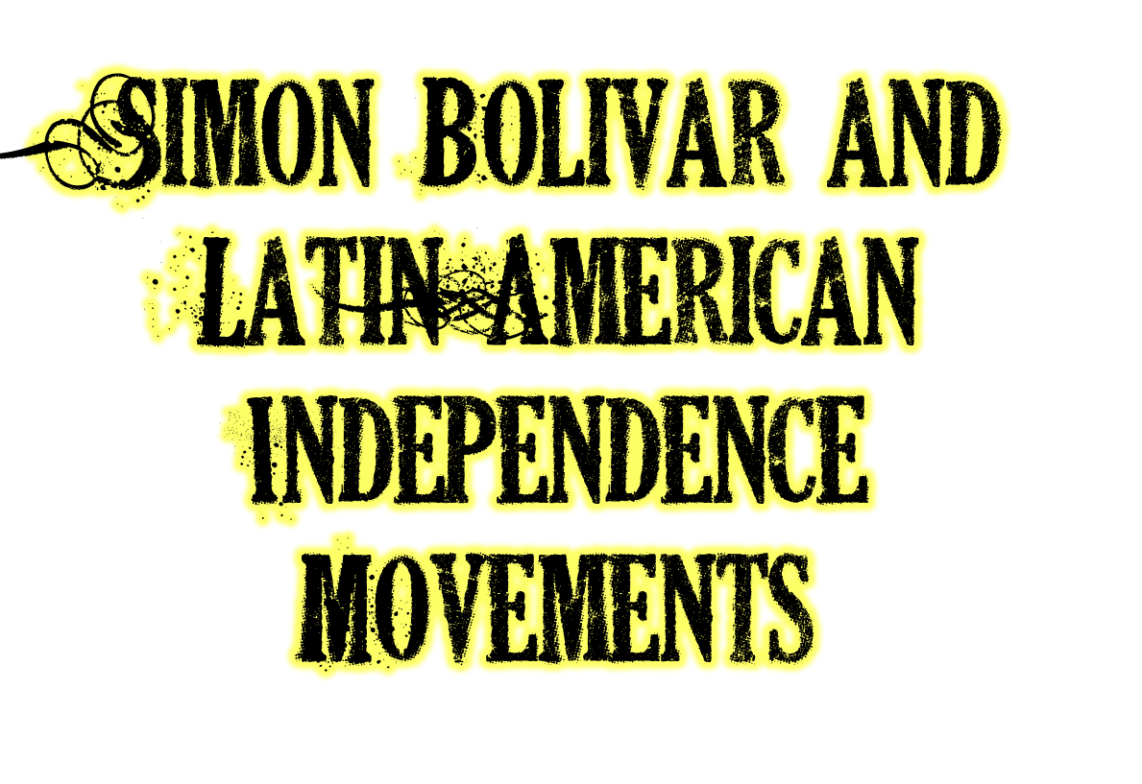
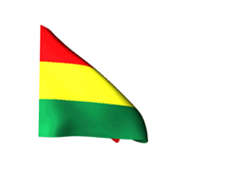

Slide 3
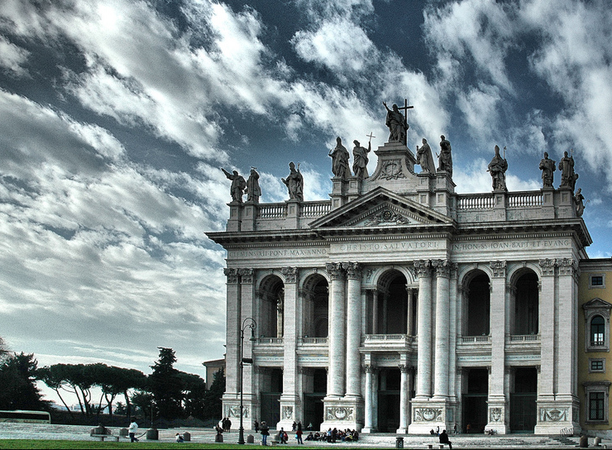
Cities are outposts of control for Europe
Catholicism is the major religion
Colonies mirror their mother countries
Wealth gained through Mining precious metals
Viceroys – royal officials who rule

Slide 4
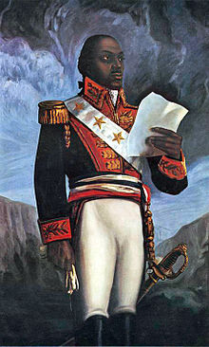
Slave rebellion led by Toussaint L’ouverture
Defeats France & Napoleon’s armies
Abolishes slavery in Haiti (1st nation to do so)

Slide 5
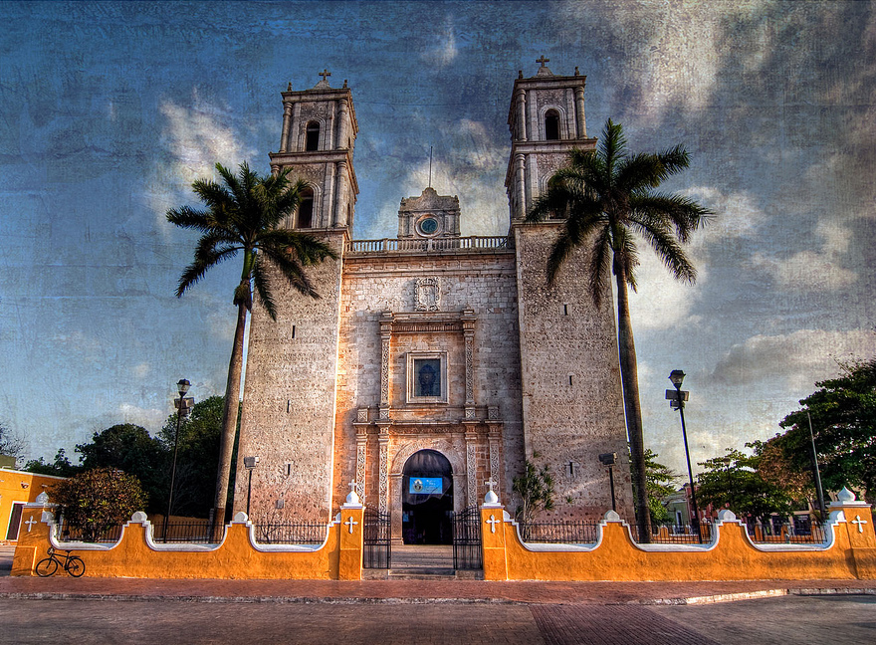
Independence movement led by Father Miguel Hidalgo

Slide 6
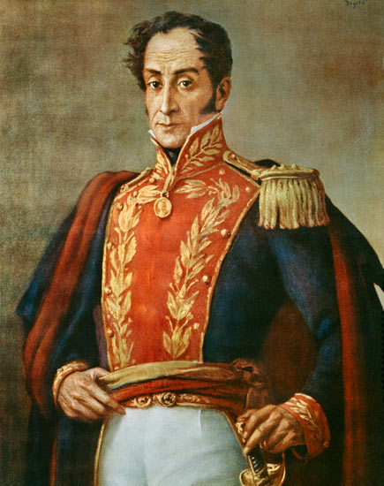
Inspired by the Enlightenment
Liberated northern Latin America from Spanish rule
Native born Creole from Venezuela
Overturns rigid class system (Peninsulars, Creoles, Mestizos)

Slide 7
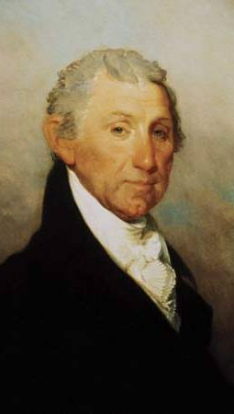
Issued in 1823 by President Monroe
Says Latin America must remain independent
Europeans interfering in Latin America is a threat to America’s peace & safety

Slide 8
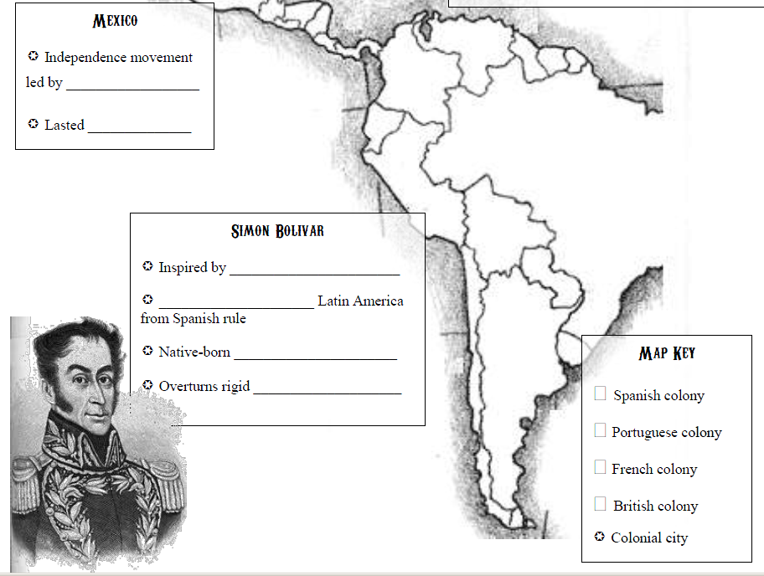
Miguel Hidalgo
1810-1821
Lima 
Enlightenment
liberated northern
Creole from Venezuela
Class system (Creoles,
Mestizos, Natives)
✪ Sao Paulo
Buenos Aires 

Slide 9
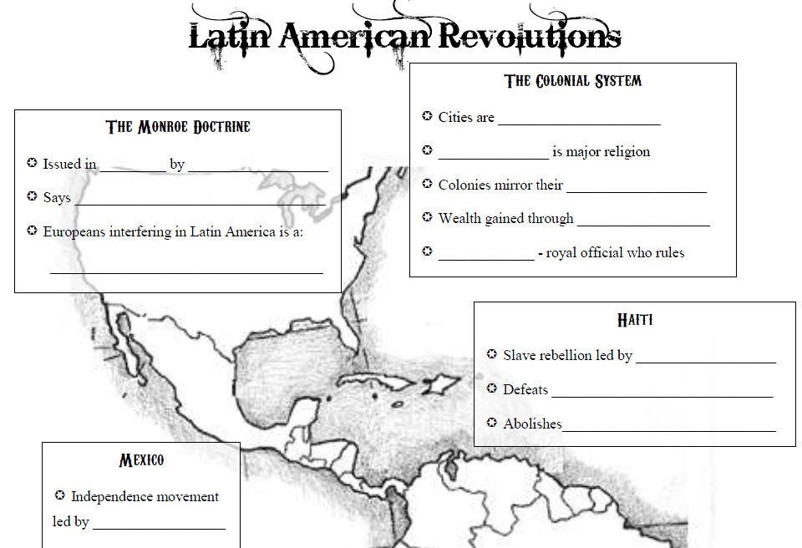
outposts of control for Europe
Catholicism
mother countries
Mining precious metals Viceroys
1823 President Monroe
Latin America is independent
Threat to America’s peace & safety
Toussaint L’Ouvture
France, Spain, & England
slavery in Haiti (1st one)
Havana 
Mexico City 

Slide 11
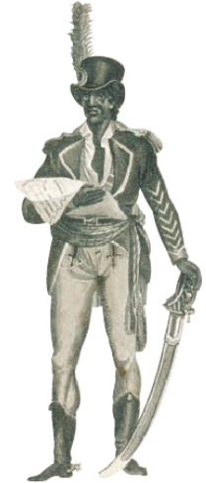
This man led a violent slave rebellion in Haiti against what European power?
France
Russia
Portugal
Italy

Slide 12
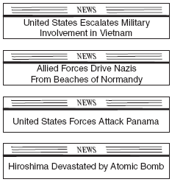
2. Which headline took place first?
Enlightenment in Europe Begins
Americans Win Revolutionary War
Simon Bolivar Liberates Columbia
Haiti Wins Independence From France

Slide 13
3. What was the basis of the Monroe Doctrine?
Europeans and Americans should cooperate in Latin America.
Latin America would need help to become independent.
European interference in Latin America is a threat to the United States.
Europe and America should be allies against Latin America.

Slide 14
4. The Spanish colonial system used to manage colonies in Latin America placed a _____________ at the top.
Viceroy
Mestizo
Native American
Creole

Slide 15
5. Simon Bolivar belonged to what societal class that led revolutions across Latin America?
Mestizo
Mulatto
Creole
Peninsular

Slide 16
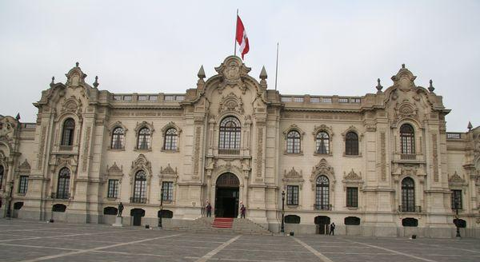
6. What city pictured below was made the outpost of colonial authority and capital of the Viceroyalty of Peru in 1543?
Lima
Sao Paulo
Mexico City
Buenos Aires

Slide 17
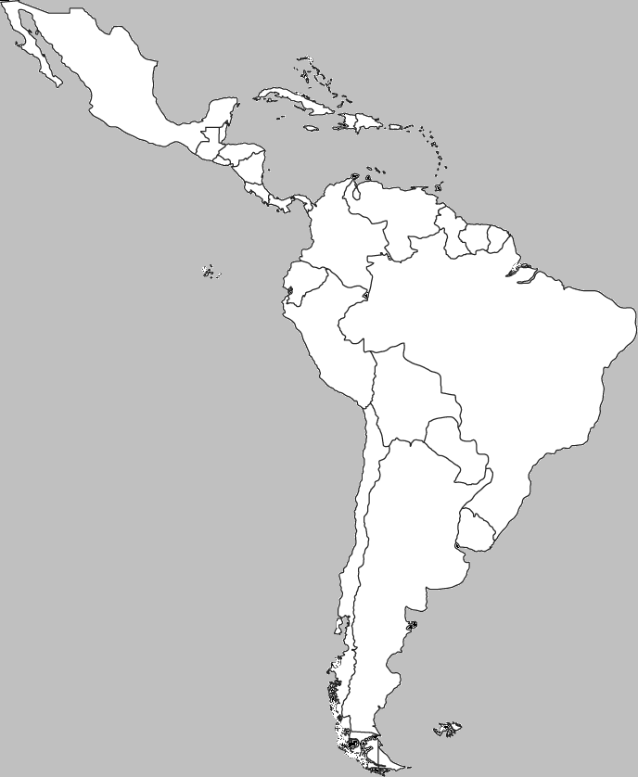
B
A
7. Which letter marks the location of Havana – the colonial city used by the Spanish as an outpost of Colonial Authority?
D
C

Slide 18
C
A
7. What letter marks the country in which Father Miguel Hidalgo started an independence movement in 1810?
D
B

Slide 19
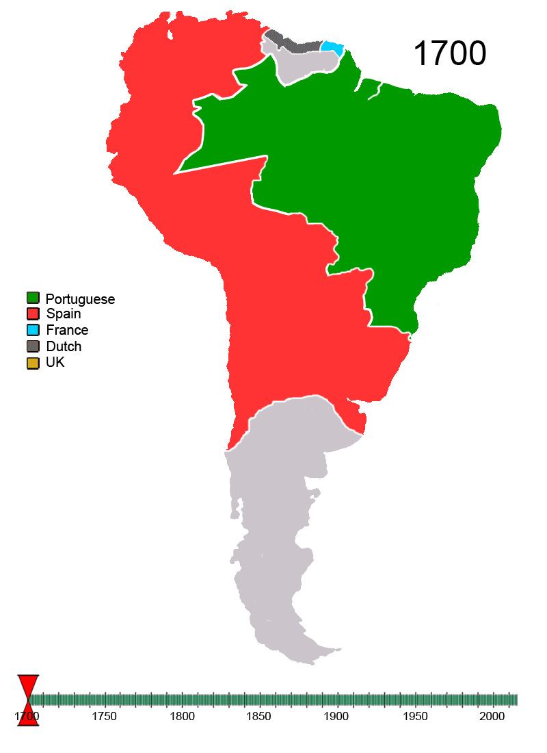
9. Which religion had a major impact on the development of these colonies?
Islam
Protestantism
Lutheranism
Catholicism

Slide 20
10. How did the American Revolution impact Latin American Revolutions?
Latin American people were inspired by the ideals of freedom and democracy sought by the US.
Columbians also wanted greater freedom from British control.
George Washington inspired Toussaint L’Ouvture to take power
It showed that most revolutions are not successful

Slide 21
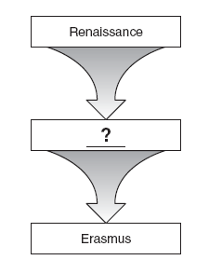
Slave Uprising against Colonial rule
11. What best completes the diagram?
Mexico defeats Spain
Slavery abolished
Monroe Doctrine issued
Portugal grants Brazil independence
Haiti Gains Independence

Slide 22
_______?________
Major element of Latin American colonial economies
Exported back to Europe
Brings wealth to mother countries like Spain & Portugal
12. What is the best title for this diagram?
Rice farming
Mining of precious metals
Trade with United States
Coal mining

