Slide 1
Joseph Stalin and the rise of communist russia
Nathan B. Gilson
Southwest Middle School

Slide 2
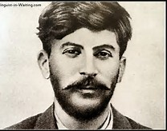
Stalin and the revolution
During the Bolshevik Revolution, Stalin earned a reputation as a skilled organizer
Well-known for brutal tactics and willingness to be violent toward people who stood in the way.
He gained Lenin’s respect due to his effectiveness.

Slide 3
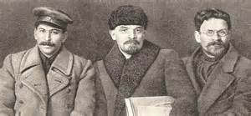
Stalin in Lenin’s Government
In the Communist Party during the Revolution (1917-1922) Stalin was appointed as a secretary in charge of hiring other leaders.
Stalin used this position to appoint his allies to key positions within the party
When Lenin was about to die, he specifically told the leaders that he did not really want Stalin to take over the government, because Stalin’s ambition would destroy the communist principles he was trying to install.

Slide 4
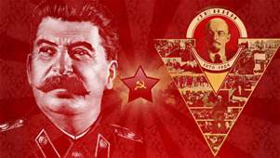
Stalin’s rise to power
Eventually split with other key leaders, including Leon Trotsky, who Stalin kicked out of the Communist Party as well as exiled from the USSR.
Stalin continued to play key figures against each other while he built up his own power, many times betraying them after they stopped being useful to him.

Slide 5
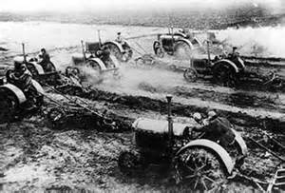
Collectivization
Stalin recognized that the Soviet Union didn’t have the industrial output to compete militarily with other countries in the world.
Stalin’s first step was to use the government to take control of all of the farms in Russia (collectivization)
Organized these farms into massive collectives, which could be run by a few farmers, freeing up the rest to move to the cities and work in factories.
The process created massive food shortages due to poor management and the starvation of between 5 and 10 million Russians.

Slide 6
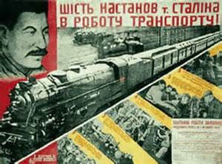
5 year plan(s)
Stalin poured massive resources of both people and money into industrializing the nation as quickly as possible.
Used forced labor from camps called “Gulags”
When the first 5 year plan failed to produce the desired outcome, Stalin simply started it over.

Slide 7
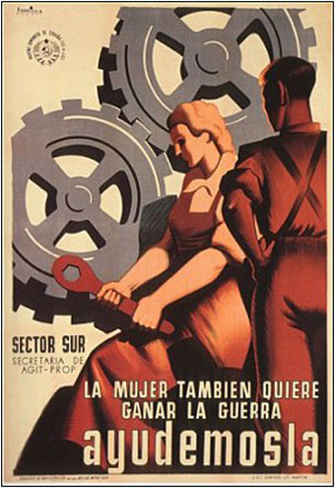
Impact of the 5 year plans
Developed new products, and thousands of factories throughout the Soviet Union.
Millions of Russians were killed in Gulags and accidents
Russia went from an industrially backward country unprepared to fight WW1 to a world power by WW2
Most historians agree that without the 5 year plans undertaken by Stalin, Russia would not have been able to fight against Germany in WW2

Slide 8
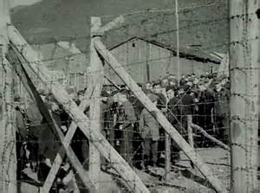
Gulag
Stalin used forced labor camps to eliminate all who opposed his power, while making use of their work to further industrialize the country.
Secret police took approximately 18 million people into labor camps between 1932 and 1947.
Conditions were similar to Nazi concentration camps and the concentration camps used by the North Korean government today.

Slide 9
Stalin and the Use of propaganda
Stalin was a master of manipulating his public image by using propaganda
Created a personality cult, where many Soviets worshipped Stalin, due to their belief that he was the source of everything in their lives.
The Communist Party in the Soviet Union had such tight control over all information, that many historians have difficulty assessing the total impact of Stalin’s reign, due to many numbers being erased or unavailable.

Slide 10
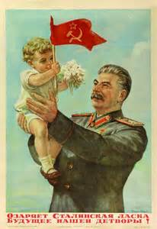
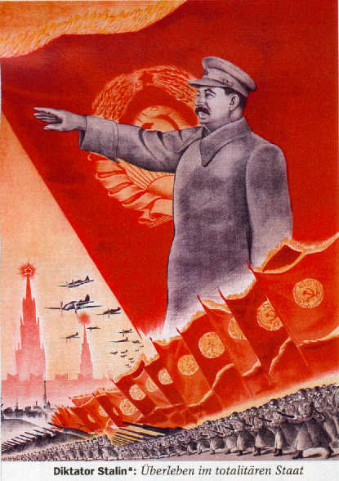
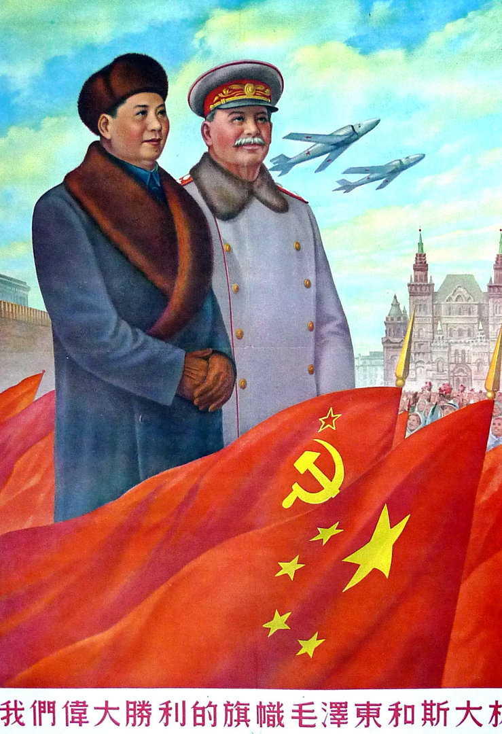
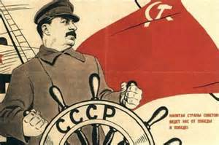

Slide 11
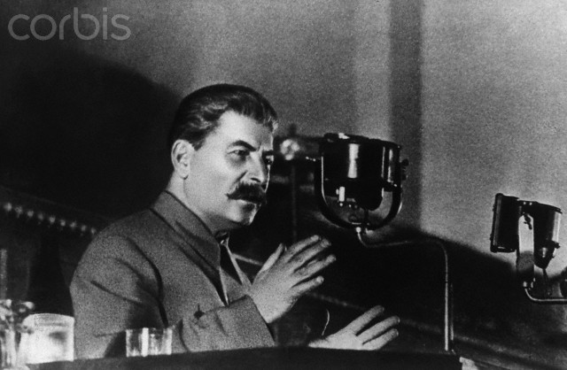
The Great purge (1937-1938)
Stalin was very paranoid, and actively sought to eliminate all dissenting views
In the 1930’s, Stalin executed every leader from Lenin’s cabinet except one, and much of the military leadership of the Red Army
About 700,000 foreign nationals were also executed (over 200,000 of them Poles), with no trial
These are according to the Soviet’s own records, and may be greatly understated

Slide 12
Estimates of Civilian deaths Under Stalin

Slide 13
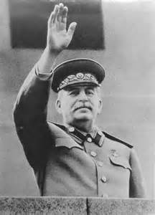
Legacy of joseph Stalin
Died in 1953
Transformed the Soviet Union into one of the two most powerful nations in the world in 15 years.
Millions of dead due to brutal and repressive tactics
Effective use of propaganda to strongly “clean up” image, to the point where he is still a national hero in Russia today.

