Slide 1
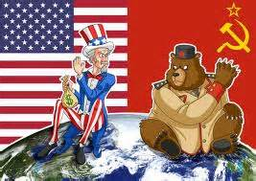
The Cold War
Nathan B. Gilson
Southwest Middle School

Slide 2
Connection: Russian Revolution and WWII
Russian Revolution: Joseph Stalin rose to power in the USSR during the Russian Revolution, eventually becoming dictator of the Communist nation after the Red Victory. He led the USSR into an Industrial Revolution which transformed them into a world super power. He also created a very cruel version of Communism and used propaganda to create a personality cult. This led to many democratic nations such as the US and Great Britain to become very wary of Joseph Stalin and his communist ideals.
WWII: During world war two Joseph Stalin took much of eastern Europe including east Berlin in order to build his communist empire. Since the USSR was now a major super power this created tensions with many democratic nations, including the other super power; USA.

Slide 3
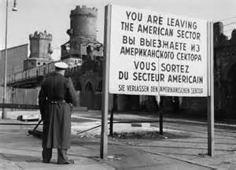
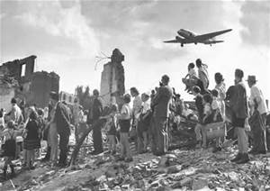
Berlin Blockade
During the occupation of Germany, both sides of the alliance were unwilling to allow the other to control Berlin (capital of Berlin)
Berlin is in Eastern Germany (Soviet-controlled land)
Allies (France, US, and Britain) used Soviet roads to control the supply of their half of Berlin. The Soviets decided to try to gain full control of the city by closing all of their roads for repairs or safety reasons.
Beginning of the Berlin Airlift
Every 30 seconds, a plane from Allied-controlled Germany took off to drop supplies to West Berlin.
Led to the building of the Berlin Wall, which became symbolic of the Iron Curtain.

Slide 4
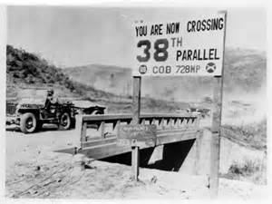
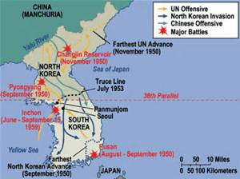
Korean Conflict
Korea had been a Japanese-occupied nation since 1910.
After WW2, Kim Il Sung tried to unify all Korea as a Communist state
Backed by Joseph Stalin and the USSR
Southern forces resisted the change, and fought with the support of the US and the United Nations
Ended up pretty much in trench warfare and eventually established the 38th parallel as a De-Militarized Zone (DMZ) and signed a cease-fire.
Neither side has actually ended the Korean War.

Slide 5
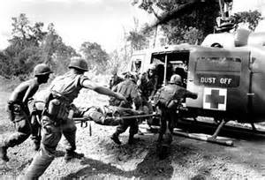
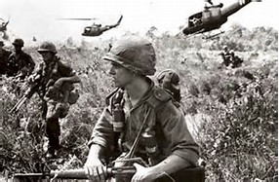
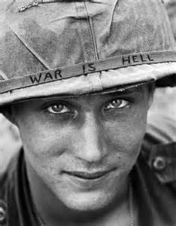
Vietnam War
Vietnam was a French territory and after the Japanese took control of it in WW2, was allowed self-rule shortly after the War was over.
Communist forces in the north (supported by China) opposed forces in the South, originally supported by the French, but eventually taken over by the United States
Called the Helicopter War due to the extensive use of helicopters to supply troops and fight in advanced positions.
Many Americans consider Vietnam a “defeat” since 58,303 men were killed, and another 150,000 wounded while the objective (prevent Vietnam from becoming a communist nation) was failed.
Vietnam became a communist nation in 1975.

Slide 6
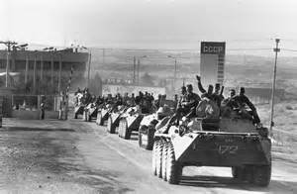
Soviet-Afghanistan War
Known as the “Soviet Union’s Vietnam”
Soviets backed a Communist regime which successfully overthrew the government. US and NATO allies backed rebel groups fighting against the Soviets, for no reason than because they were fighting the soviets
Soviets were unable to control the rebel forces, and eventually ended up withdrawing from the country after thousands of casualties and over 10 years spent trying to obtain their objective with no results.

Slide 7
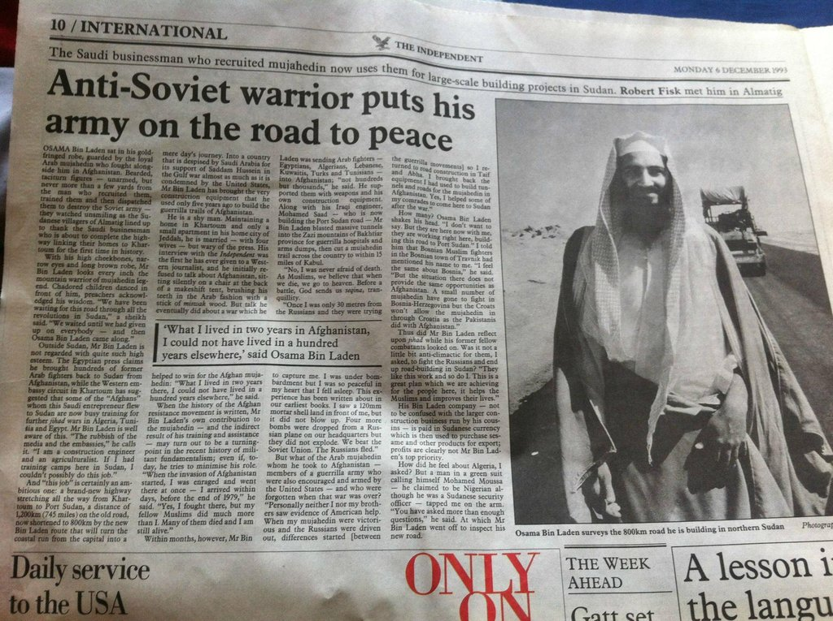
Digital image. Blogspot.com. Web. 16 Mar. 2015.

Slide 8
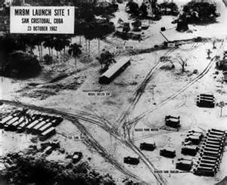
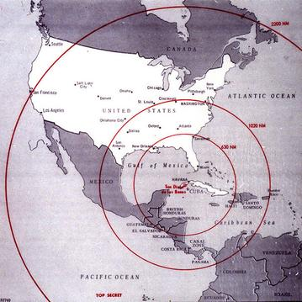
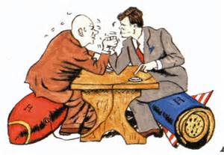
Cuban Missile Crisis
13 Days in October, 1962 when the Soviets placed nuclear weapons in Cuba
President Kennedy famously negotiated a deal with the Soviet leader, Nikita Kruschev which removed the missiles without either country losing any standing in the world.
US later removed missiles from NATO ally Turkey which would have been similarly close to Soviet cities as Cuba was to the United States.

Slide 9
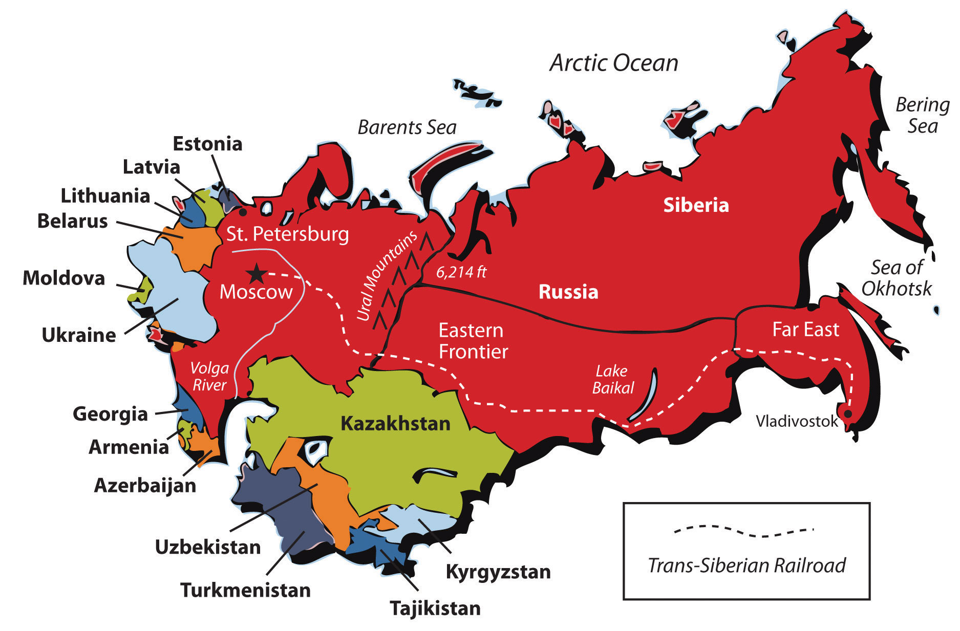
The End of the Cold War
By the late 1980’s, the Soviet Union had spent itself into a place of economic ruin.
1989—The Berlin Wall is destroyed. Eastern Germans are allowed to migrate to West Germany.
1989 – Poland, Hungary, Czechoslovakia, Bulgaria, Romania all independent or experience anti-communist revolutions.
1990—Lithuania becomes independent. Germany reunited.
1991—Official dissolution of the Soviet Union into Russia and dozens of independent states.

Slide 10
Propaganda--#5 Transfer
Transfer is connecting the leader or other images to something familiar to the audience.
Making comparisons that help further the point that the creator of the propaganda is trying to make.

Slide 11
Propaganda--#6 Glittering Generalities
Using strong and emotional language to describe things to make them seem more beautiful or evil than they really are.

