Slide 1
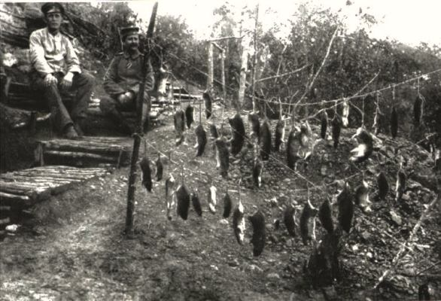
The War to End All Wars
Nathan B. Gilson
Southwest Middle School

Slide 2
Connection to Imperialism
World War 1 connects to Imperialism in several ways:
Countries in Europe began to fight against each other in colonies around the world, which led to increased conflict in Europe as well
Countries in Europe began to develop very strong national identities which led to increased feelings of superiority toward other nations.

Slide 3
MAIN Causes of World War 1
Militarism—building large militaries
Alliances—Every country had Mutual defense agreement with other countries.
Imperialism—Empire building
Nationalism—Loving one’s own country

Slide 4
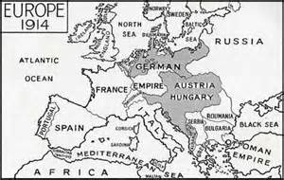
Mutual Defense Alliances
Different nations in Europe developed alliances that obligated each other to protect one another in the event of a war.
Triple Entente—Russia, France, and Great Britain were all aligned with one another.
Central Powers—The countries in the center of the continent (Germany, Austria-Hungary, Ottoman Empire) were also aligned due to the inter-marriage of their royal families.

Slide 5
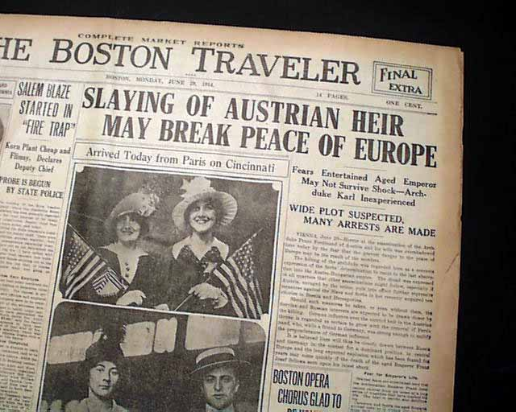
The Straw the Broke the Camel’s Back
Assassination of Franz Ferdinand and his wife by a Serbian terrorist organization known as the Black Hand
Wife was pregnant when she was killed.
Ferdinand was the crowned prince of Austria
Was going to be king some day
Austria retaliates by declaring war on Serbia

Slide 6
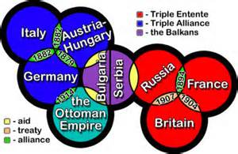
Mutual Defense Alliances at work
Austria declares war on Serbia
Russia declares war on Austria because of an alliance with Serbia
Germany declares war on Russia and Serbia because of an alliance with Austria
France declares war on Germany and Austria because of an alliance with Russia
England declares war on Germany and Austria after being pressured by the French

Slide 7
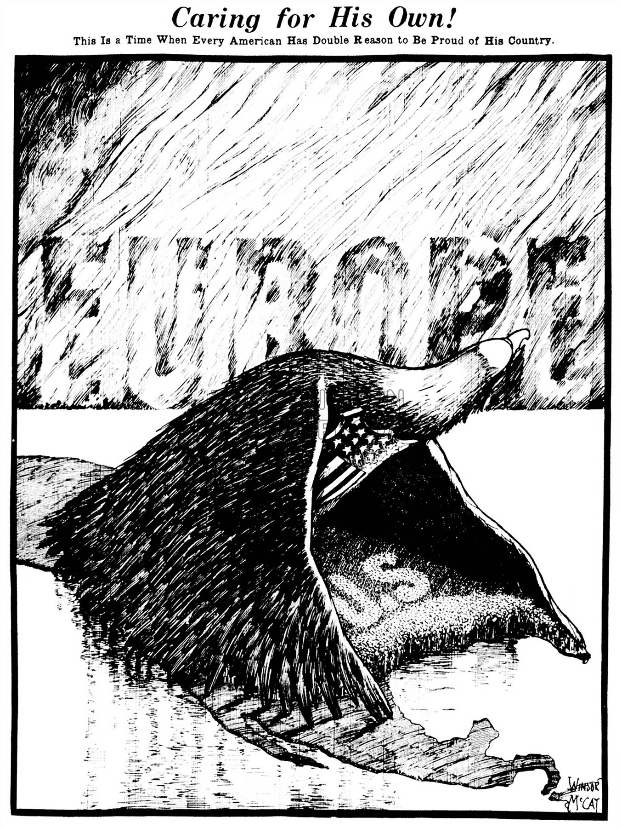
American Isolationism
Because of the problems with other countries, America works very hard to remain neutral during WW1
Continues to trade with Great Britain and France and loan them money for the War.
Hides war supplies on passenger ships because the Germans use their submarines to sink all cargo ships going to Europe from the US
Germany begins to warn the US that they will sink the passenger ships as well.

Slide 8
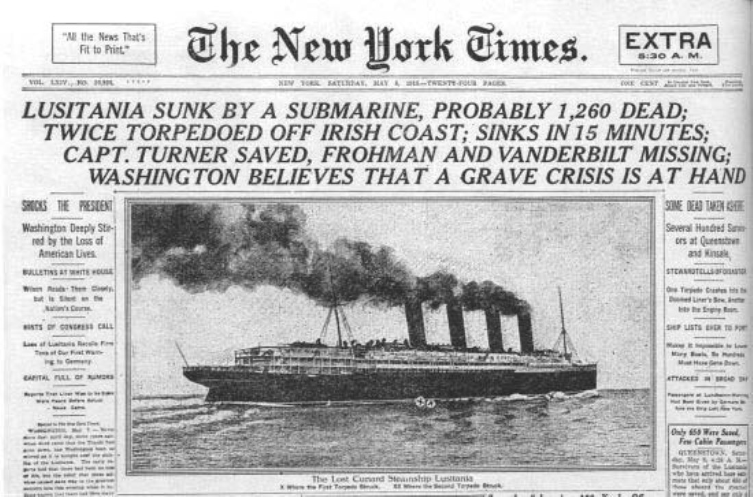
The Impact of Technology on WW1
German U-boats
Submarines
Element of surprise
Can control trade and supply routes
Unrestricted submarine warfare
Submarines would sink all ships that were heading in and out of France and Great Britain.

Slide 9
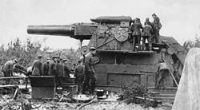
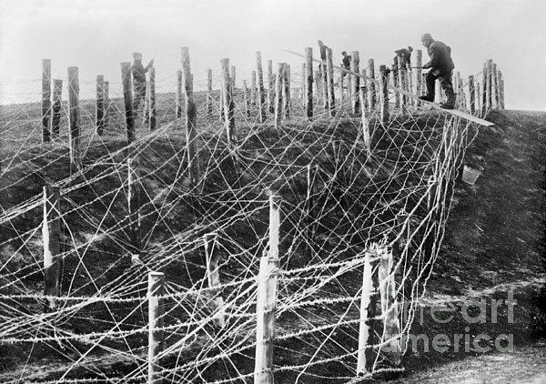
The Impact of Technology on WW1
Legacy of Mass Production
First machine guns are used on the battlefield.
Renders old military tactics of fighting in lines and using horses and cavalry irrelevant
Artillery and ammunition can be mass-produced and used constantly
Able to attack enemy lines from miles away with cannons and artillery without risking your own troops
Destroyed all of the surrounding landscape, leading to something called “No Man’s Land.”
Barbed Wire prevents men and horses from charging at positions

Slide 10
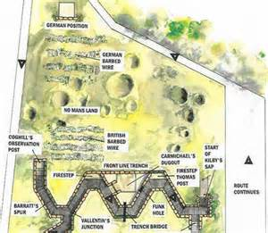
Trench Warfare
Technology leads to a new defensive strategy of digging deep ditches (3-10 ft. deep) to protect soldiers from machine guns, artillery fire, etc.
Counter strategies for trench warfare included:
Leads to the invention of the first tanks (Basically a shield with a motor on it)
Mustard gas
Grenades
Trenches were often filled with bacteria, which led to bad diseases and often infections would kill soldiers.

Slide 11
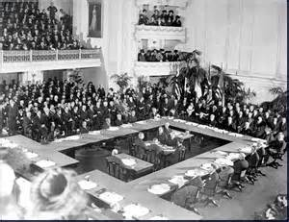
The End
Treaty of Versailles
Germany forced to sign the Treaty of Versailles after they surrender
Agrees to take responsibility for the War (You break it, you bought it)
Agrees to have a very small military
Agrees to grant independence to all colonies in Africa
Agrees to sink entire navy and all u-boats
Agrees to give land away to France
Agrees to never unite with Austria
League of Nations
First attempt at an International Law-making body

Slide 12
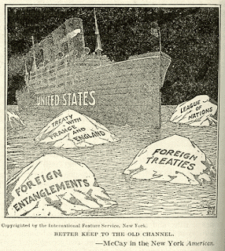
Outcomes of World War 1--USA
United States only loses a fraction of the men that the rest of the European powers lose.
US returns to being isolationist and refuses to join the League of Nations

Slide 13
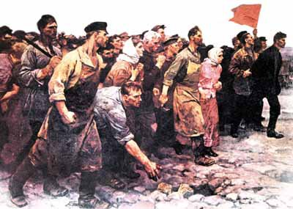
Outcomes of World War 1--Russia
Russian military tactics was to throw men at the problem
Refused to accept the reality of Trench Warfare, and continued to charge entrenched enemies despite taking grotesque casualties.
Many soldiers were undersupplied, some were not issued guns, coats, or shoes despite fighting during the middle of the winter.
Mismanagement of food resources lead to peasants starving as food is sent to the soldiers, who never got it.
Leads to the Russian Revolution and the establishment of the Soviet Union.

Slide 14
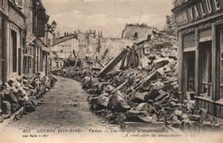
Outcomes of World War 1--France
France is where most of the fighting happened during WW1, so their towns, countryside, and farms were destroyed in the fighting.
Demands that somebody pays for the damage to the country (reparations)
Takes land away from Germany

Slide 15
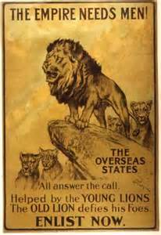
Outcomes of World War 1—Great Britain
Maintains status as the world’s super-power
Treaty of Versailles re-establishes the British Navy as the strongest in the world.
British Empire continues to dominate the global economy, but some colonies begin to be granted independence due to the expense of maintaining them.

Slide 16
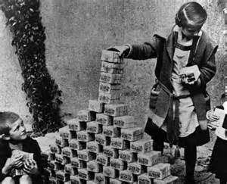
Outcomes of World War 1--Germany
Humiliated due to losing the war
Resent being forced to pay reparations to France since they were not the country that started the War
Beginning in 1920’s, the German economy enters a deep depression
In early 1930’s, a man comes along who refuses to pay France, rebuilds the military and the economy, and restores glory to the German people.

Slide 17
